Slide 1

Account Review
TrakRacer

Slide 2

Surcharge Review

Slide 3
Surcharge summary
FedEx Ground
Spend (USD)
table
Ground Surcharges
 | Spend (USD) |  |  | % of Total Ground Spend
 | Month | Quarter | Year | Month | Quarter | Year
Additional Handling Surcharge | 13,046 | 42,251 | 44,054 | 13.81% | 14.60% | 14.31%
Fuel Surcharge | 13,057 | 39,471 | 41,944 | 13.82% | 13.64% | 13.62%
FedEx Home Delivery Residential | 9,546 | 29,932 | 30,531 | 10.11% | 10.34% | 9.92%
Oversize Charge | 5,485 | 13,342 | 15,286 | 5.81% | 4.61% | 4.96%
Temporary Peak Surcharges | 2,650 | 7,654 | 8,329 | 2.81% | 2.64% | 2.70%
Delivery area surcharge | 1,997 | 7,393 | 7,713 | 2.11% | 2.55% | 2.51%
Address Correction | 383 | 833 | 897 | 0.40% | 0.29% | 0.29%
FedEx Ground Residential | 0 | 405 | 798 | 0.00% | 0.14% | 0.26%
Other Surcharges | 241 | 592 | 709 | 0.26% | 0.20% | 0.23%
Total | 46,404 | 141,873 | 150,261 | 49.13% | 49.01% | 48.80%

Slide 4
Spend and services overview
FedEx Express and FedEx Ground (June 2023 – May 2024)
1%
(US Domestic)
7%
(International)
92%
FedEx Express
FedEx Express
FedEx Ground
$4,098
$23,208
$307,900
Top Services (by Volume)
Top Services (by Volume)
Top Services (by Volume)
84%
FedEx 2Day
51%
Intl Priority
93%
FedEx Home Delivery
9%
Express Saver
40%
Intl Economy
6%
FedEx Ground
3%
Priority Overnight
6%
FedEx Intl Connect Plus
0%
Intl FedEx Ground
4%
Other FedEx Express services
3%
Other FedEx Express services
EAN: 726631859 All currencies are US Dollars.

Slide 5
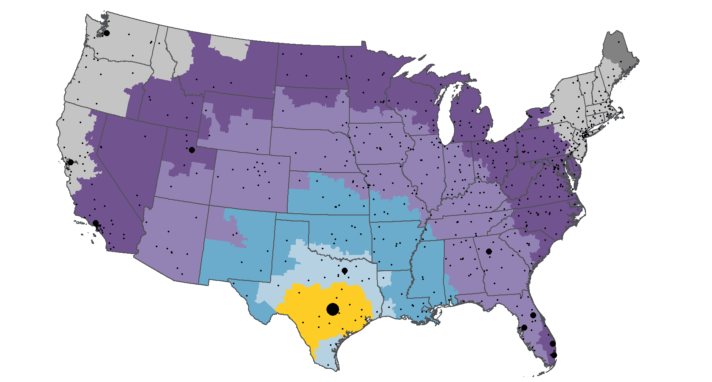
Zone profile
FedEx Ground and FedEx Home Delivery US package services (June 2023 – May 2024) Origin: 786
Average Zone
5.5
12K Packages Total
EAN: 726631859
This map is a general representation of domestic US zones. For specific zone information, please refer to fedex.com. This map illustrates zone coverage areas with respect to the specified origins.

Slide 6
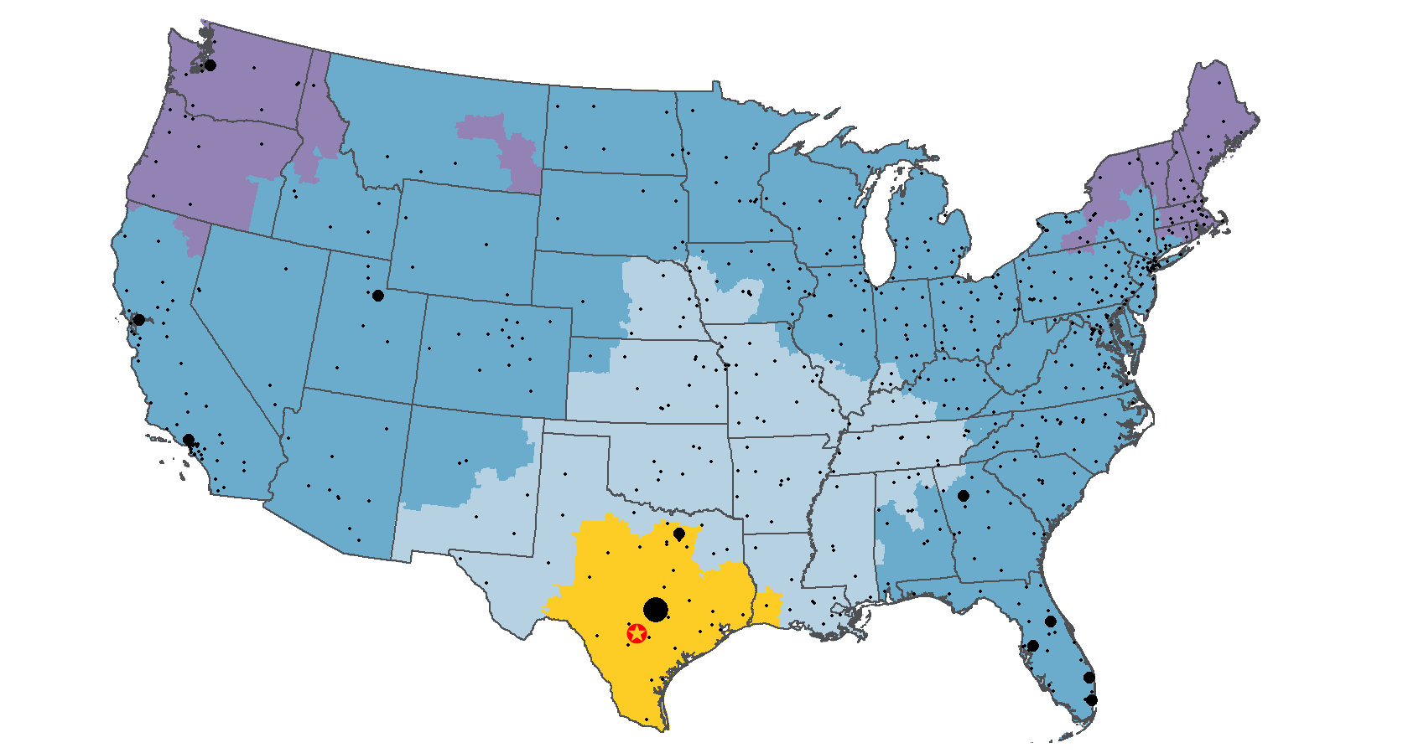
Transit profile
FedEx Ground and FedEx Home Delivery US package services (June 2023 – May 2024) Origin: 782
Average Days
2.8
12K Packages Total
EAN: 726631859
The map above is a general representation of domestic US transit times. For specific transit information, please refer to fedex.com. This map illustrates service schedules in business days for FedEx Ground shipments.

Slide 7
Package profile
FedEx Ground and FedEx Home Delivery US package services (June 2023 – May 2024)
Packages by Weight Break
Average Actual Weight
19.6 lb
Average Billed Weight
22.6 lb
There may be opportunities for the FedEx Packaging Lab to help you improve packaging efficiency and reduce costs.
Additional Handling
Surcharge Frequency
26%
Total Volume
Most Frequent Weights
17 lb, 9 lb, 6 lb
Oversize Charge
Frequency
2%
Total Volume
12,314 Packages Total
EAN: 726631859
Data is based on rated weights. Packaging savings estimated based on package types used and bulk rate costs per package type.

